Slide 1













NITSHACKS 2024
\nits hacks 7.0
North-east India’s Most Premium Hackathon
AI-Based Model for Electricity Demand and Peak Load Projection
Topic:AI-Based Model for Electricity Demand and Peak Load Projection
Theme:Open Innovation (3)
Team Name- Juice Pila Do

Slide 2


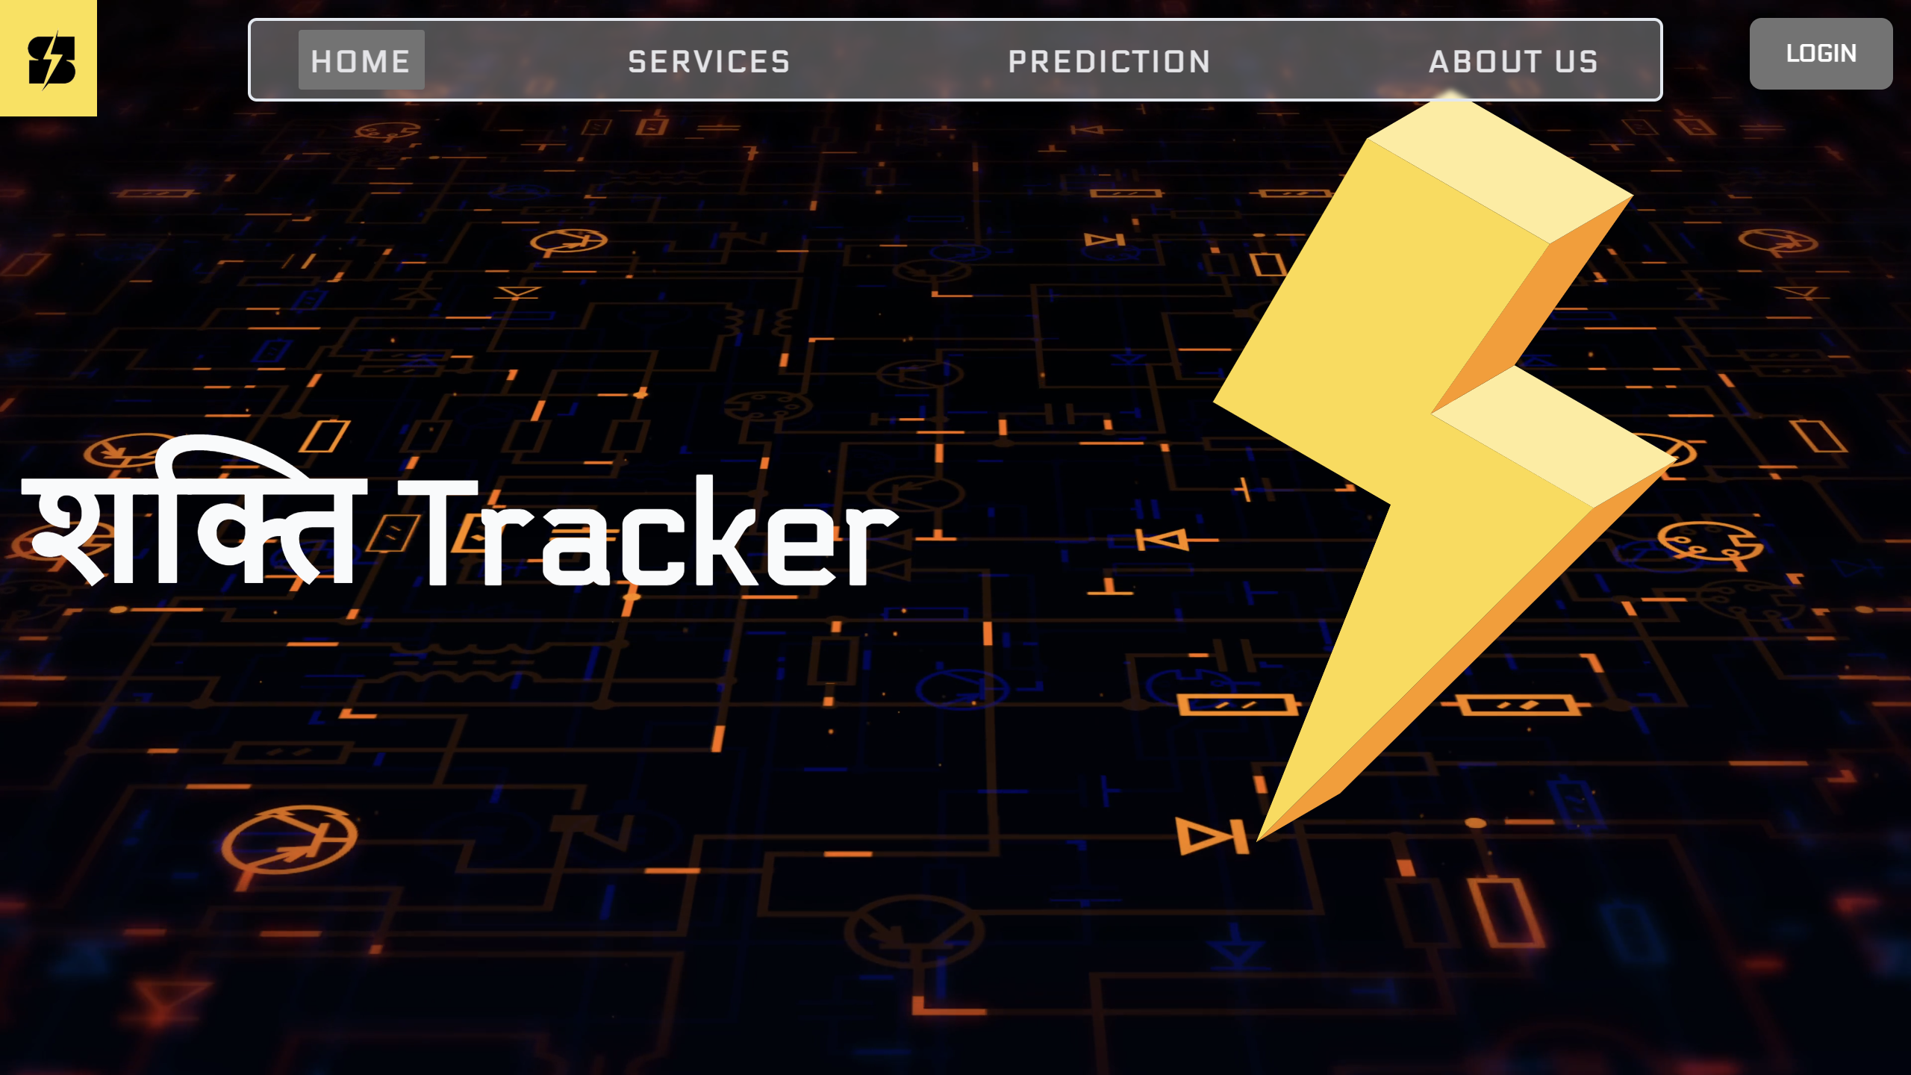

AI-Based Model for Electricity Demand and Peak Load Projection
Juice Pila Do
\nits hacks 7.0
Proposed Solution:
Develop an AI-based model for electricity demand projection and peak load forecasting for the Delhi Power System. The model will use machine learning to analyze historical data and external factors like weather patterns, holidays, and urban development.
How it addresses the problem:
The proposed AI-based model addresses electricity demand and peak load forecasting by integrating diverse data, including hourly consumption, weather, and solar generation. Using machine learning techniques like Random Forest, it accurately predicts demand, compensates for solar variability (Duck Curve), and adapts dynamically, enabling efficient resource allocation and reducing power costs and disruptions.
Innovation and uniqueness:
Multi-dimensional data integration and Duck Curve compensation ensure scalable, accurate forecasting for complex urban grids.
Detailed Solution:
Data Integration
Feature Engineering
Tried Various Modelling techniques(Bagging ,Boosting & ANN)
Duck Curve Compensation
Event Sensitivity
2
@
nits hacks submission- template

Slide 3


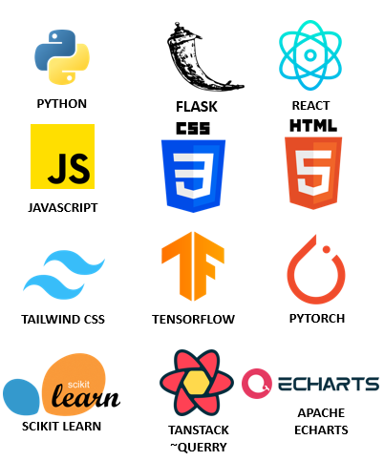
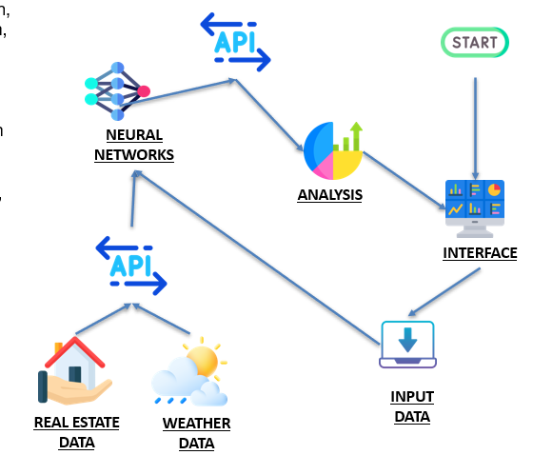
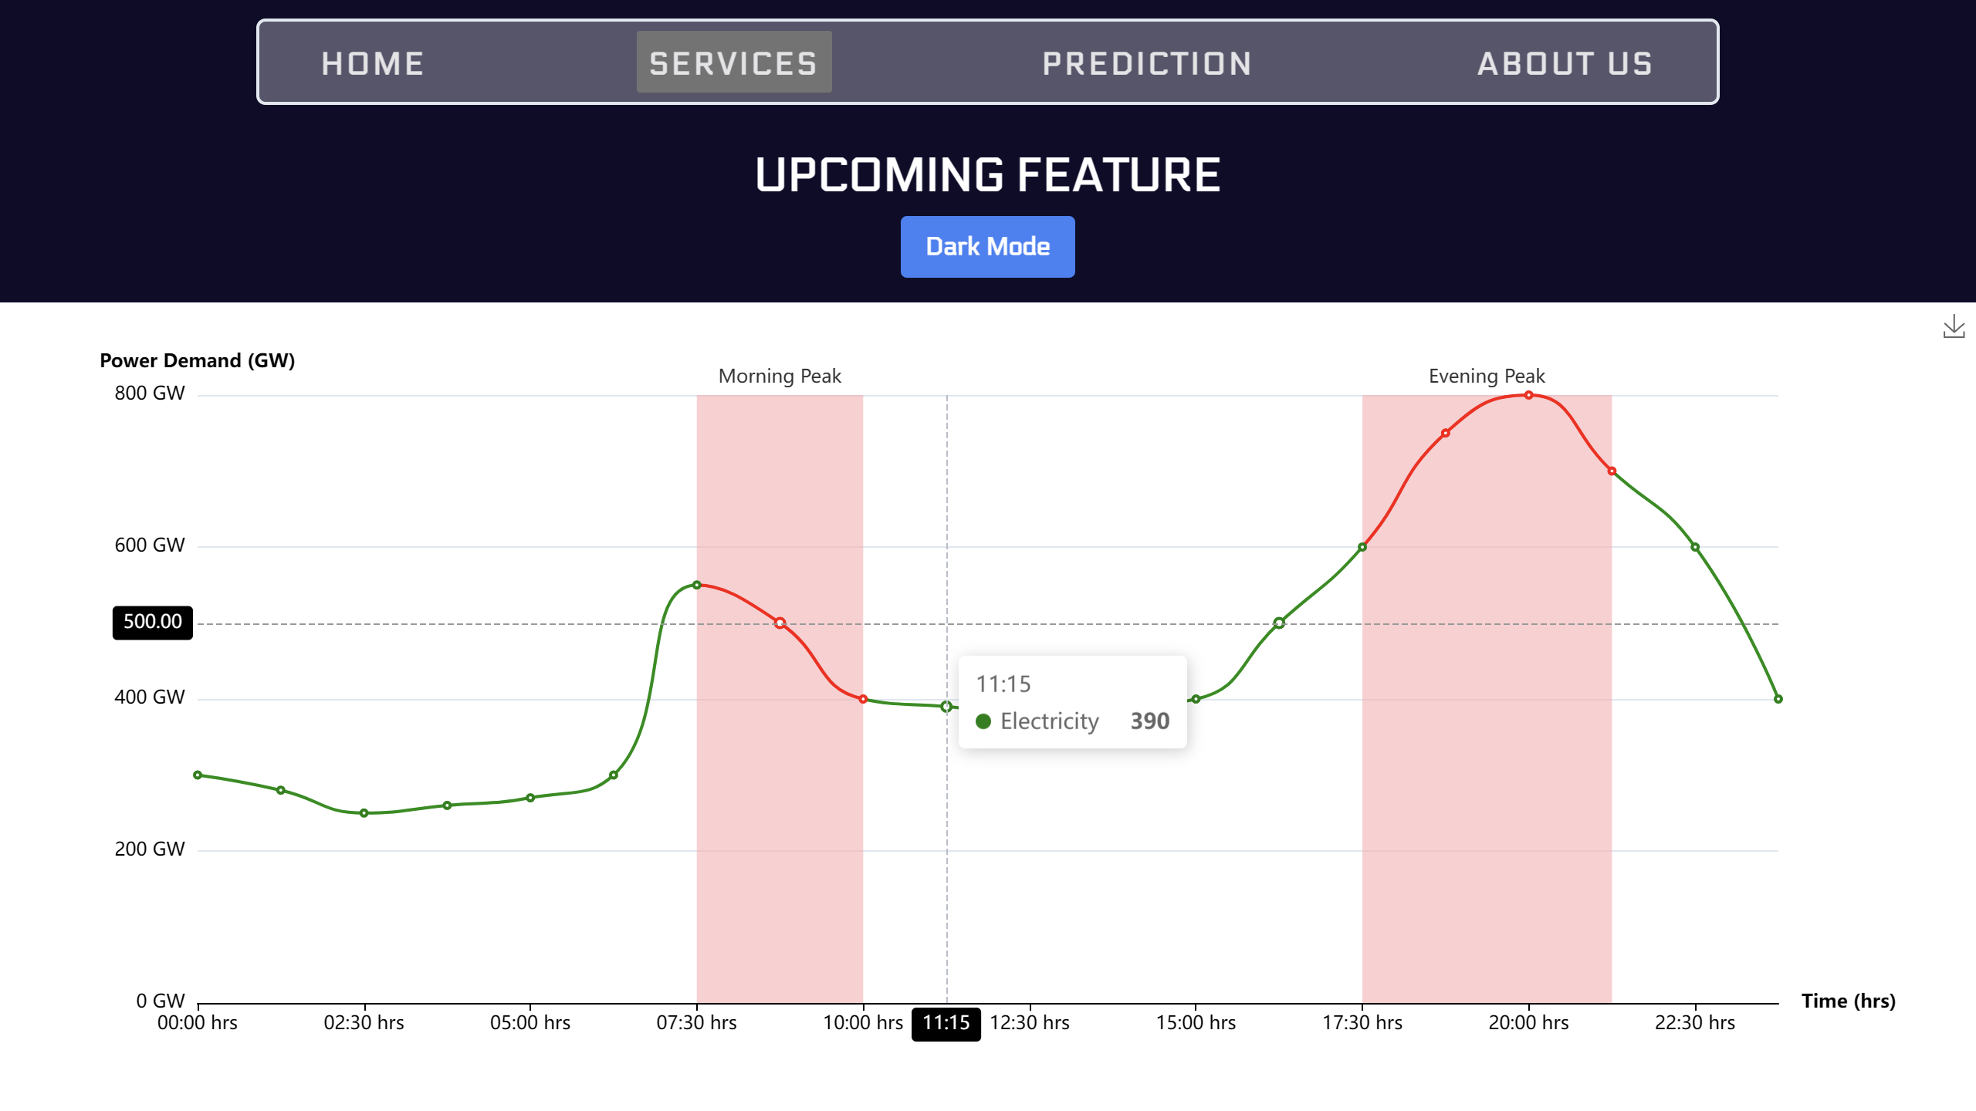
Juice Pila Do
TECHNICAL APPROACH
\nits hacks 7.0
Estimation curve
3
@
nits hacks submission- template

Slide 4

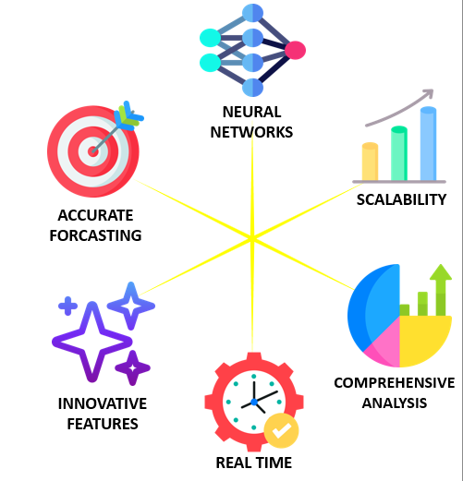
Juice Pila Do
FEASIBILITY AND VIABILITY
\nits hacks 7.0
Feasibility Analysis:
Data Availability:
Delhi has extensive historical data on electricity demand, weather, and solar generation, making the project highly feasible. With easily accessible data, the model can be trained efficiently.
Technological Maturity:
Proven machine learning techniques like time-series forecasting, regression, and neural networks are ideal for electricity demand projection, ensuring technical viability.
Scalability and Adaptability:
The model is scalable and adaptable, allowing application beyond Delhi to other regions with similar power system characteristics.
Key Strengths and Opportunities:
Accurate Forecasting:
Integrating weather, holidays, and real estate growth will enhance forecast accuracy, leading to more efficient power procurement and cost reduction.
Regular Updates:
The model’s ability to incorporate regular updation of data ensuring continuous improvement and accuracy in dynamic environments.
Innovative Features:
Duck Curve compensation and regional load growth differentiation provide unique advantages, addressing solar variability and uneven urbanization.
Leveraging advanced AI and machine learning, this solution is feasible, scalable, and effective for optimizing Delhi's electricity demand and peak load forecasting.
4
@
nits hacks submission- template

Slide 5


Juice Pila Do
IMPACT AND BENEFITS
\nits hacks 7.0
Economic Benefits:
Cost Optimization: The model allows power utilities to make better purchasing decisions, minimizing the need for costly last-minute power purchases. This helps reduce overall energy costs for consumers and utilities alike.
Efficient Resource Allocation: Accurate forecasts will enable better management of power resources, leading to more efficient energy distribution and lower operational costs for utilities.
Social Benefits:
Improved Energy Reliability: Reduced load imbalances will lead to fewer blackouts, improving the quality of life for citizens and supporting business operations without disruptions.
Enhanced Energy Access: Efficient load forecasting will help extend reliable electricity to underserved or fast-developing regions.
Environmental Benefits:
Better Integration of Renewable Energy: By accounting for solar generation and compensating for the Duck Curve, the model will support greater integration of renewable energy sources, reducing dependency on fossil fuels and lowering carbon emissions.
5
@
nits hacks submission- template

Slide 6
Juice Pila Do
RESEARCH AND REFERENCES
\nits hacks 7.0
State Load Despatch Center (delhisldc.org): Used for collecting peak demand data.
POWER | DAV (nasa.gov): Used for collecting weather data.
Predicting city-scale daily electricity consumption using data-driven models – ScienceDirect: Used for researching which model to use for our project.
6
@
nits hacks submission- template

